Slide 1
Cyber Security-Novembar 2022 Batch Major Project Project Title - KeyLogger
Pathan HumamKhan H.
Networking With Cyber Security And Ethical Hacking
Tops Technologies
Contact-8485951622 Email-humamstudy@gmail.com

Slide 2
Content
KeyLogger
Steps Involved
Conclusion
Security Concerns
Prevention

Slide 3
Keylogger
Keyloggers or keystroke loggers are software programs or hardware devices that track the activities (keys pressed) of a keyboard. Keyloggers are a form of spyware where users are unaware their actions are being tracked.

Slide 4
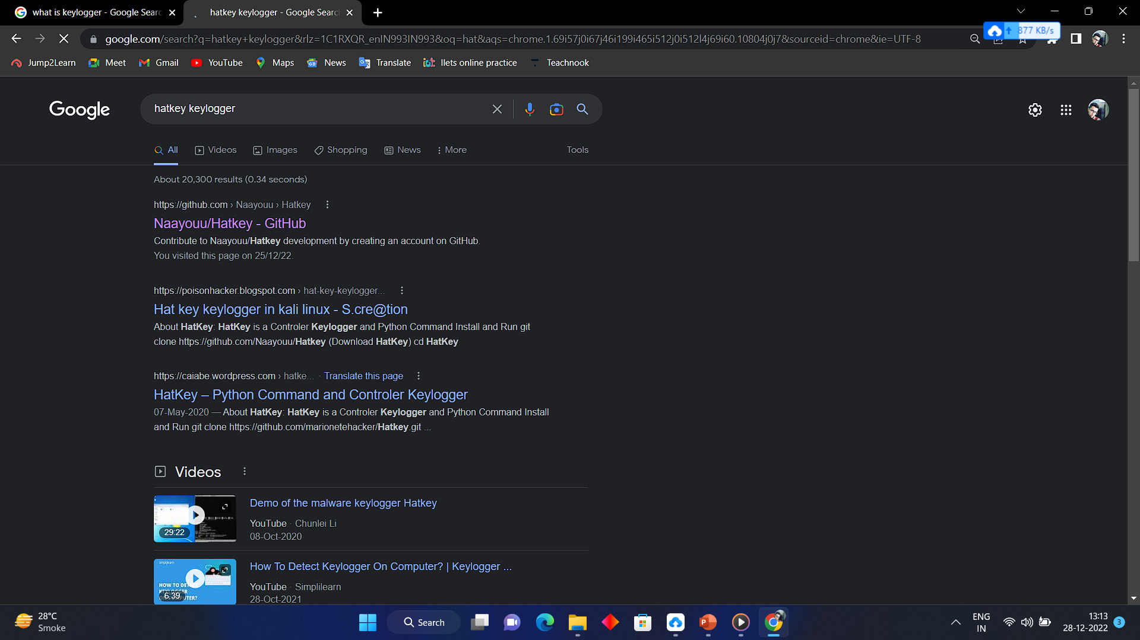
Steps Involved
Go to GOOGLE and type Hatkey github
Click on the 1st link

Slide 5
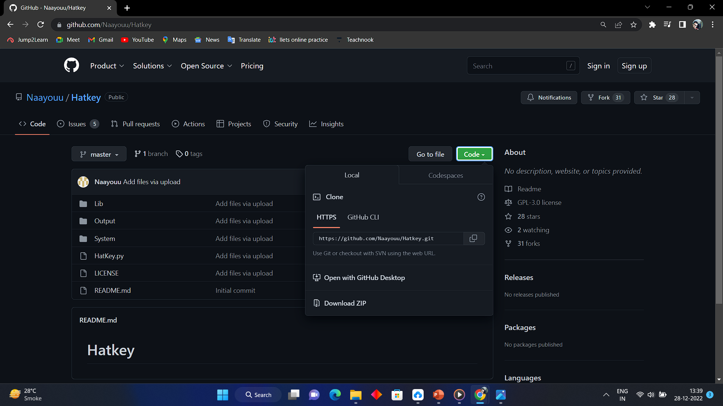
Steps Involved
Click on Code Button And Copy the Link

Slide 6
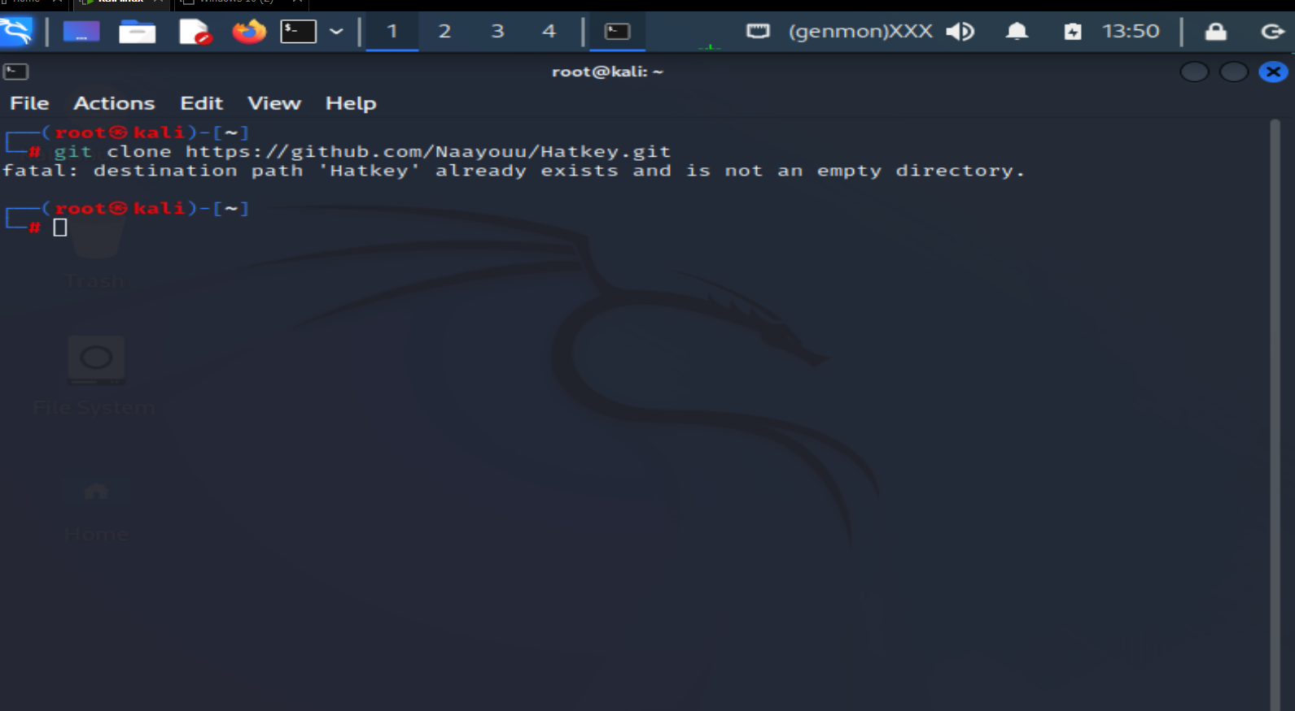
Steps Involved
Open Kali Linux Terminal and type git clone along with Link copied.

Slide 7
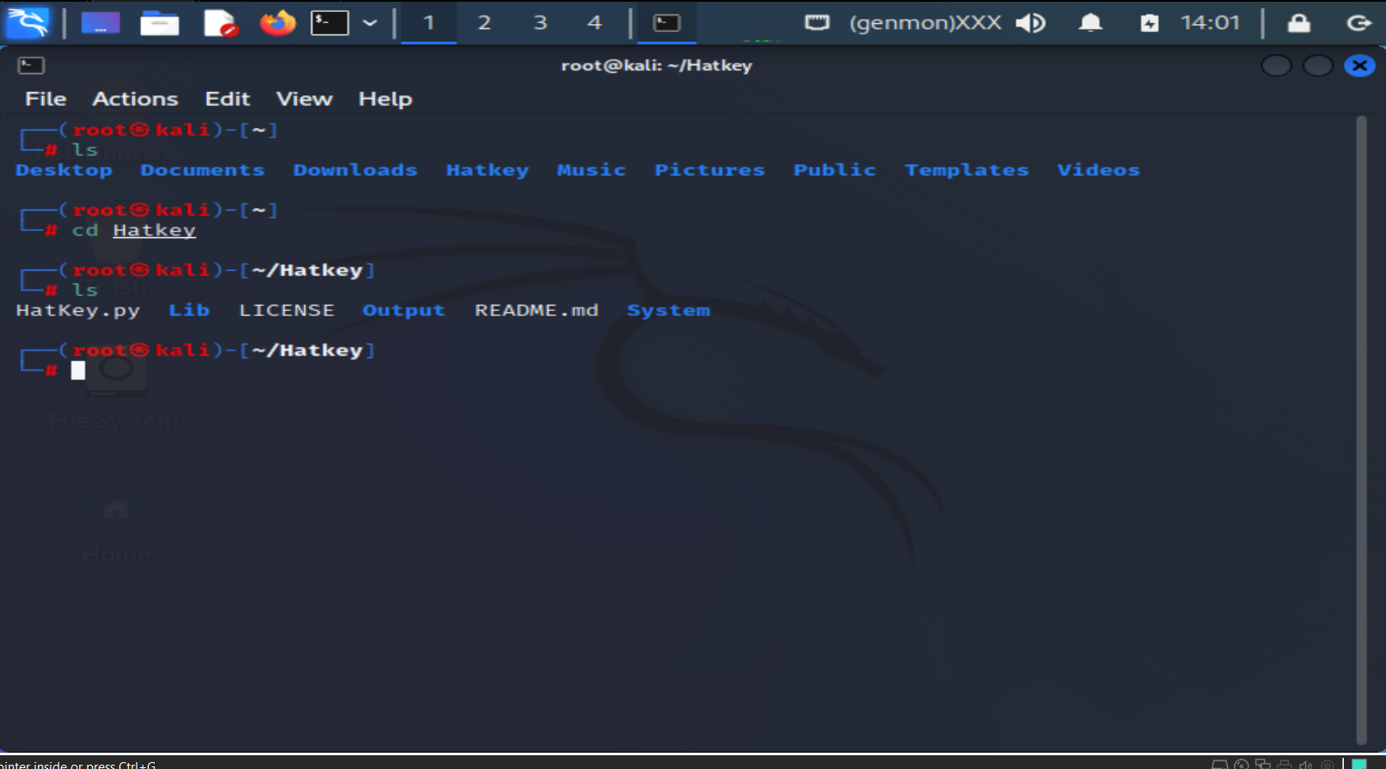
Steps Involved
Type ls to list items
Type Cd Hatkey to change directory
Type ls to list items in Hatkey

Slide 8
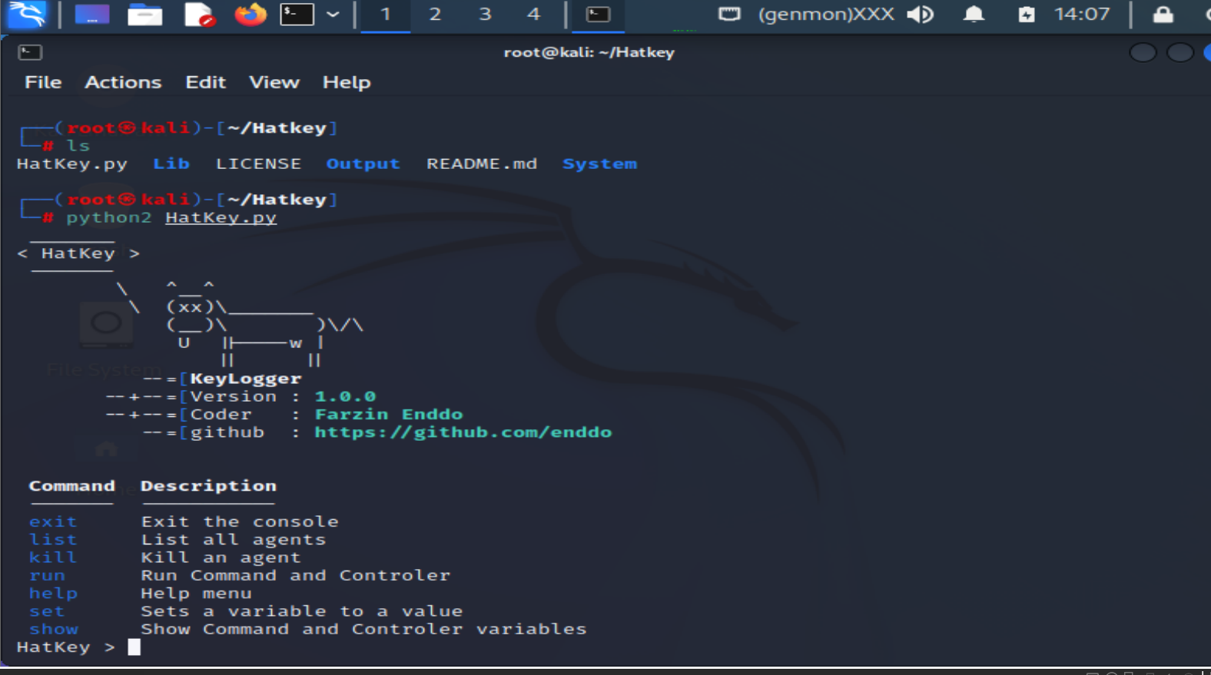
Steps Involved
Type python2 HatKey.py
To run program

Slide 9
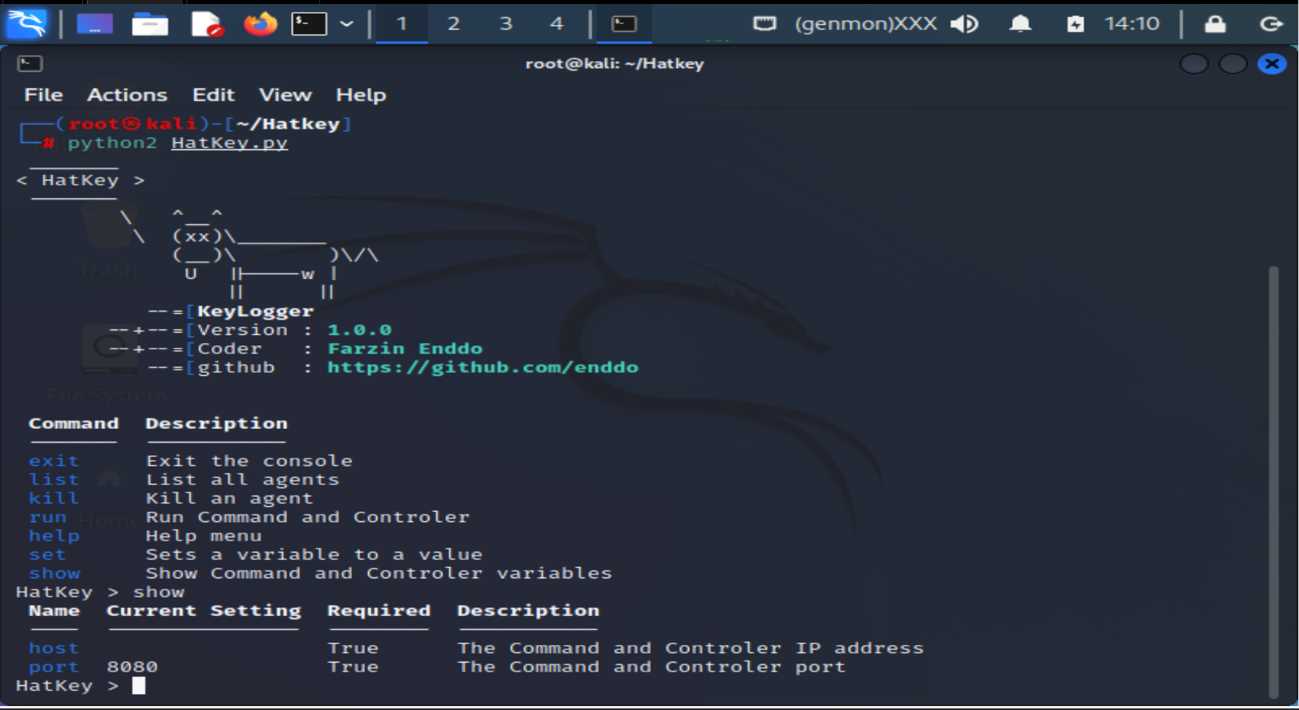
Steps Involved
Run show command
To know host and port

Slide 10
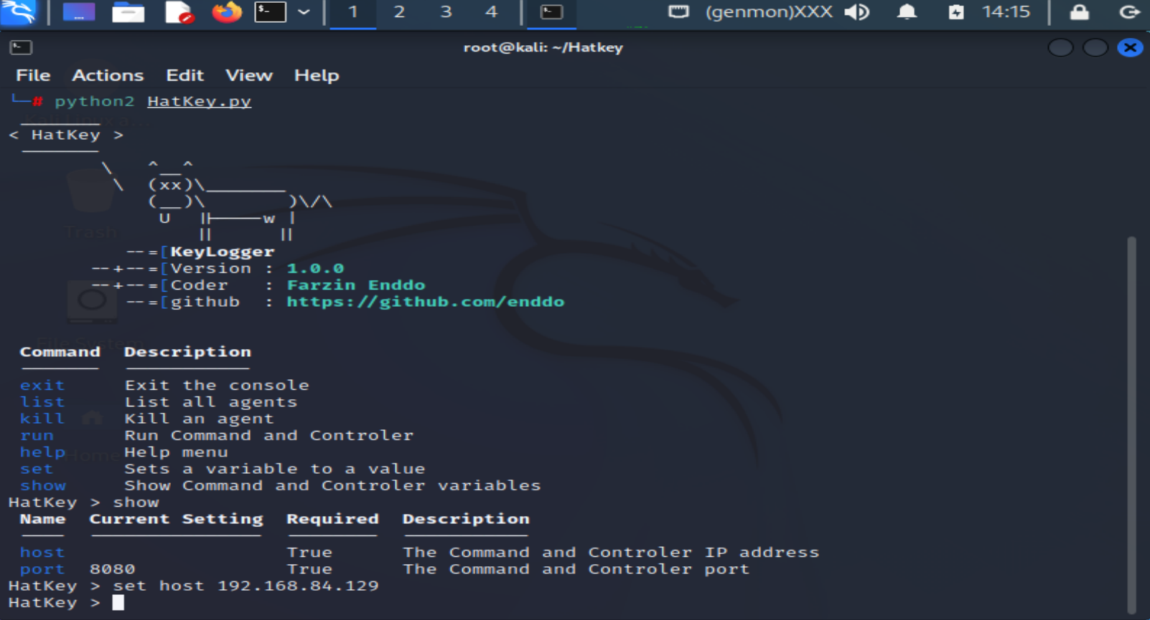
Steps Involved
Hence host is not assigned
We have to set
Type set host (IP address)

Slide 11
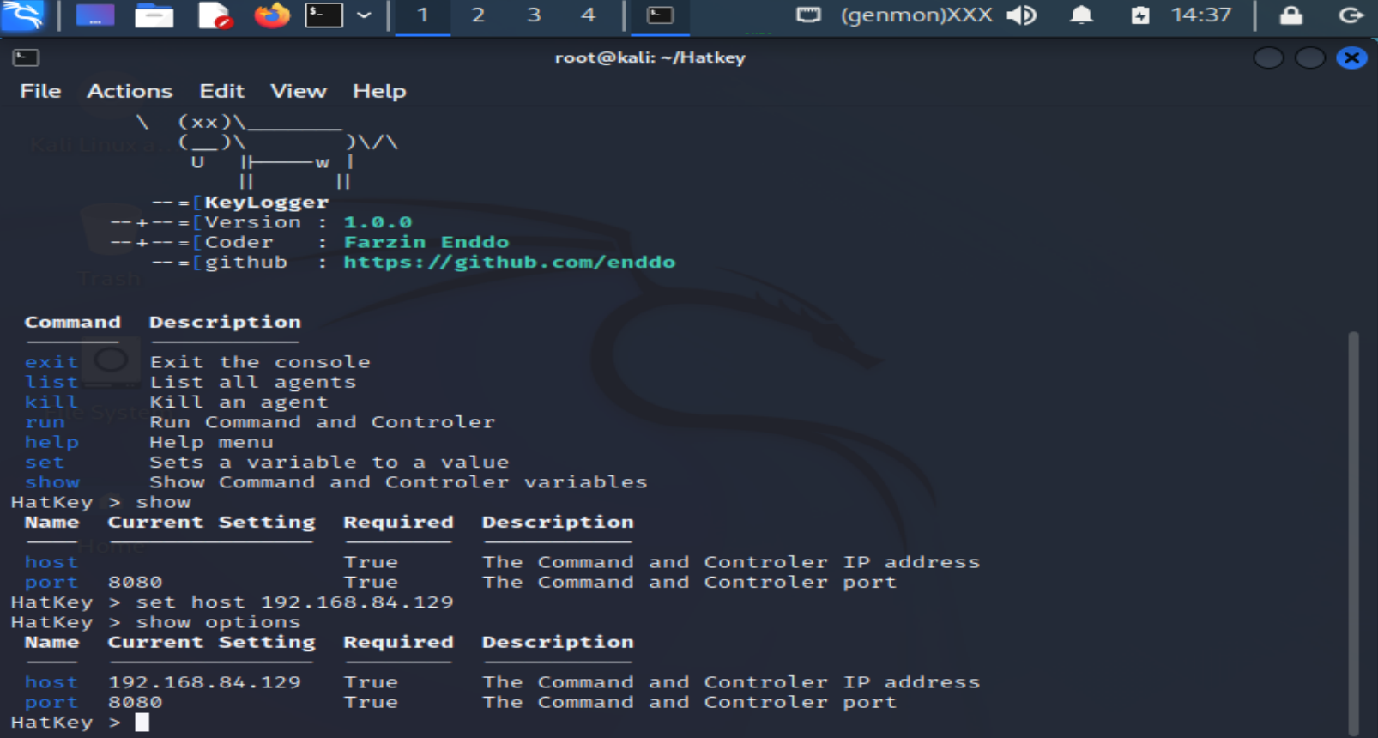
Steps Involved
Type show options command
To check the host and port

Slide 12
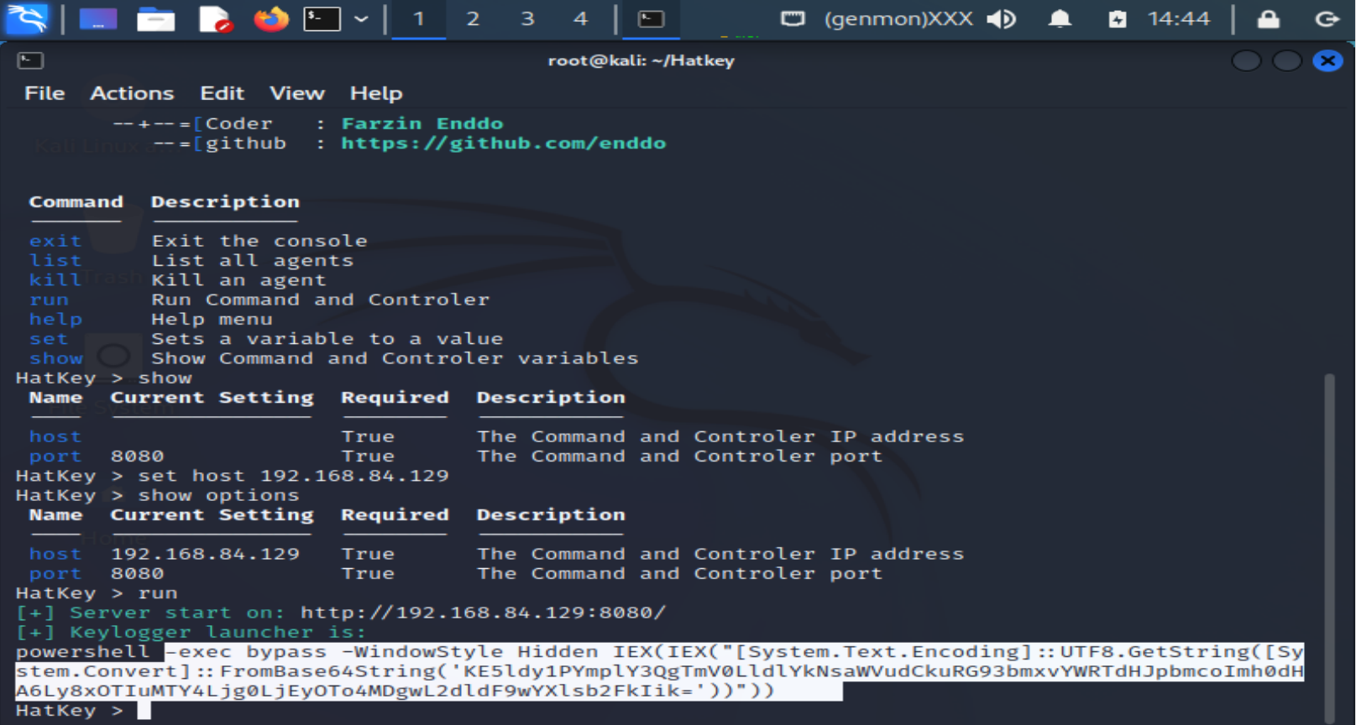
Steps Involved
Type run command
To run the program
Copy the code

Slide 13
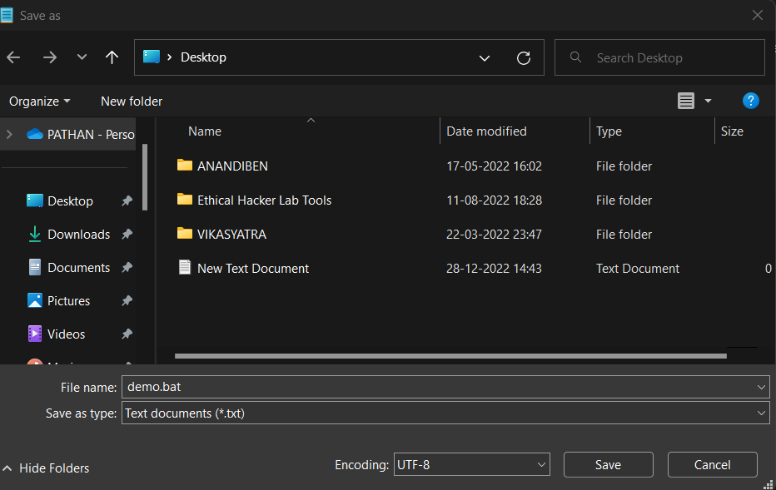
Steps Involved
Create text file and paste the copied code
Save file as file name with bat or any other extension
Eg.demo.bat

Slide 14
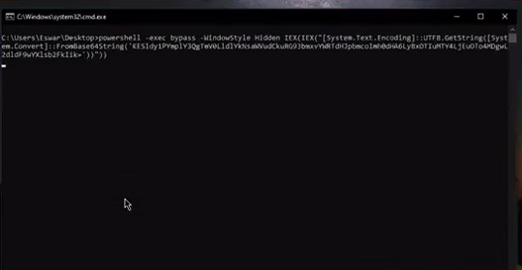
Steps Involved
Run the file

Slide 15
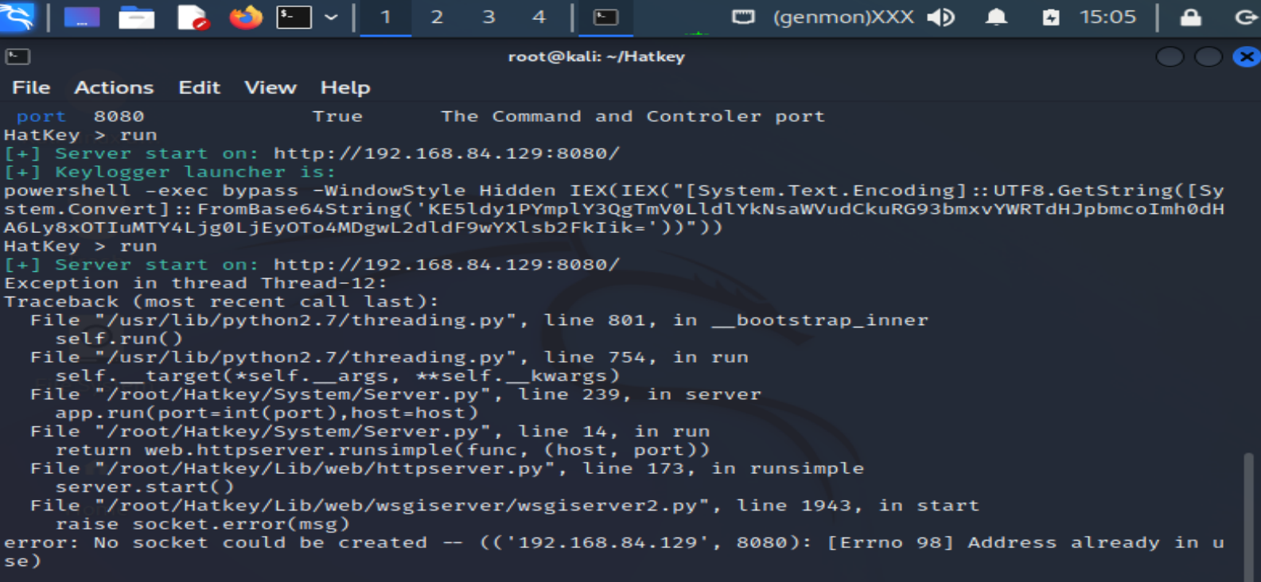
Steps Involved
KeyLogger is connected

Slide 16
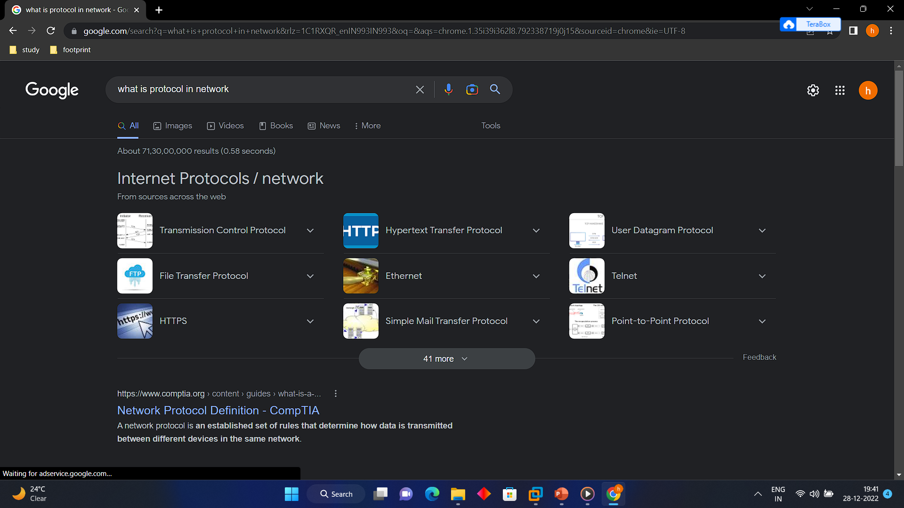
Steps Involved
Search on Google

Slide 17
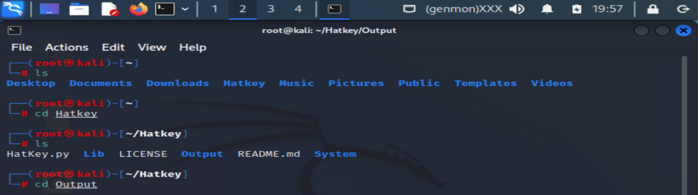
Steps Involved
Type cd Output
To show the results

Slide 18
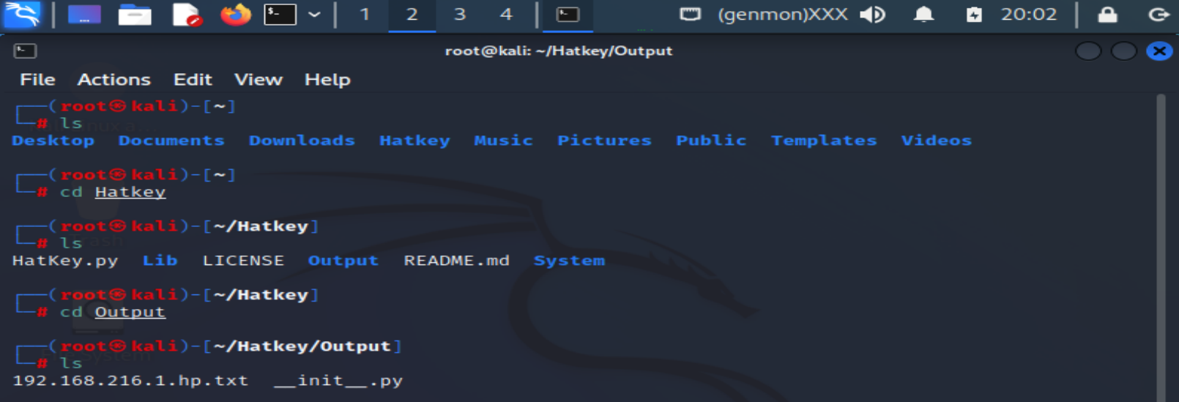
Steps Involved
Type ls to
list the results of output

Slide 19
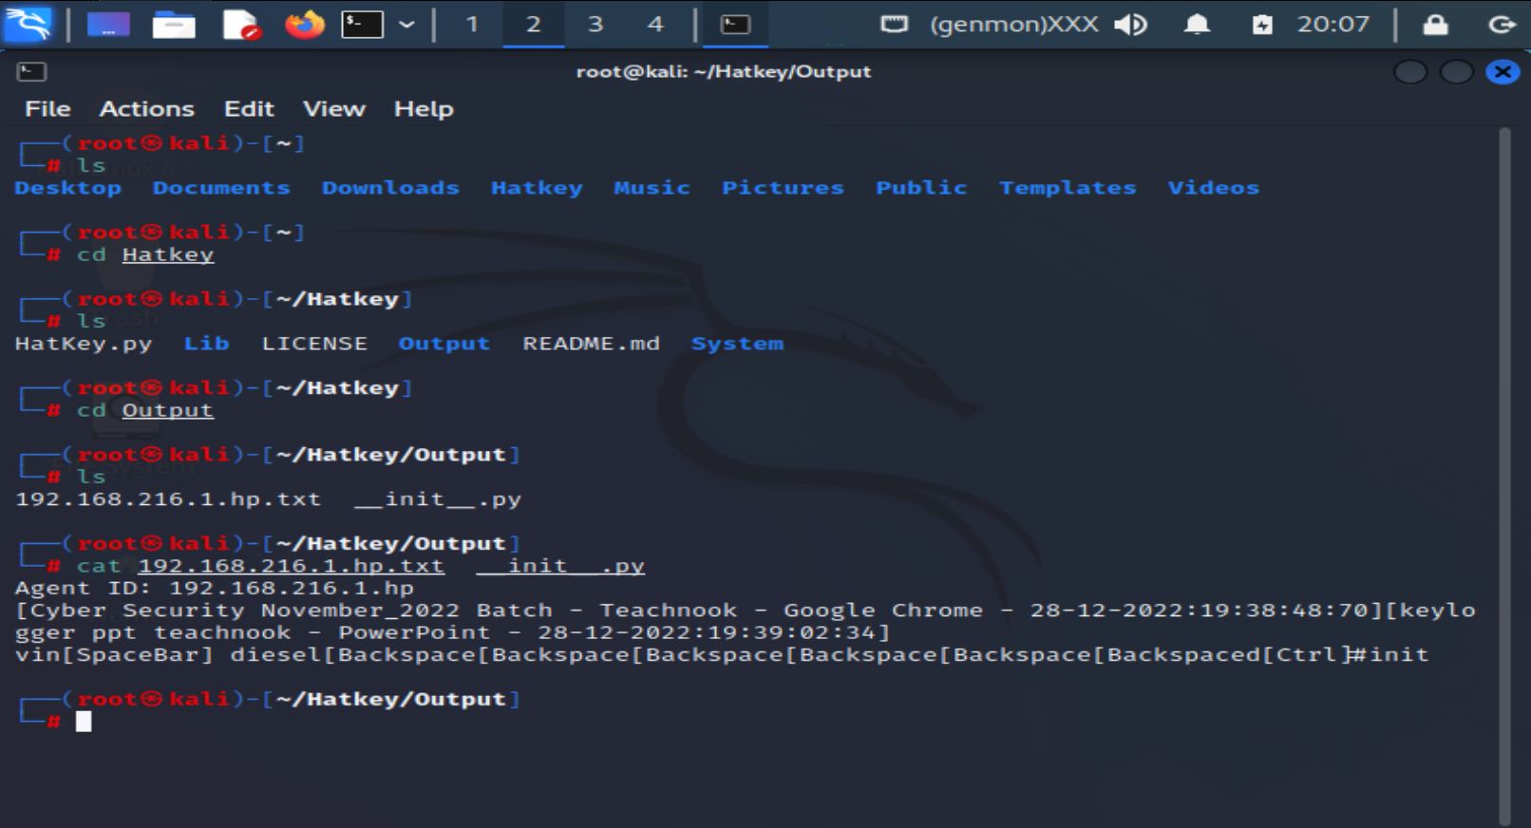
Steps Involved
Type cat followed by victim output file name to show the results

Slide 20
Conclusion
The purpose of using keylogger is to record victims activities and gets the recorded details

Slide 21
Security Concern
Hackers may use the keylogger malware to gain our personal and important data such as bank detail , secret pins or social network numbers. Along with this they gets personal data like photos clicked , messages, cell phone contacts, video etc.
It can create lots of issues to the victims.

Slide 22
Prevention
Do not download any software or documentations from unknown sites.
Keep anti-virus software updated.
Try to use virtual keyboard which will prevent from keystrokes.
Use two-factor authentication method on important sites like banking.
Use firewall and password manager to prevent getting password through keystrokes.

Slide 23
Thank You

